Slide 1
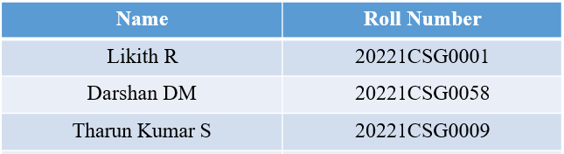
Geo Tagging of Land Properties Using Drones
CSE7101- Capstone Project
Review-1
Batch Number: CSG_30
Under the Supervision of,
Ms. Riya Sanjesh
Assistant Professor
School of Computer Science and Engineering
Presidency University
Roll Number | Student Name
Name of the Program: B-tech, CST-AIML
Name of the HoD: Dr. Saira Banu
Name of the Program Project Coordinator: Dr. H M Manjula
Name of the School Project Coordinators: Dr. Sampath A K , Dr. Geetha A

Slide 2
Content
Problem Statement
Objectives
Background and Related work for title Selection
Analysis of Problem Statement
Innovation or Novel Contributions
Git-hub Link
Timeline of the Project
References

Slide 3
Problem Statement Number: PSCS_700
Category (Hardware / Software / Both) : Both Hardware & Software
Problem Description: This problem invites the development of a novel solution leveraging digital technology to address societal or administrative challenges within public services, sustainability, or governance.

Slide 4
Problem Statement:
Inaccurate land records and disputes over property boundaries are major challenges in land administration. Traditional surveying methods are often time-consuming, labor-intensive, and prone to human error. In rural and urban settings, lack of proper geospatial tagging leads to legal disputes, encroachments, and inefficiencies in land management.
The need for a cost-effective, accurate, and scalable solution is crucial. Drones equipped with GPS and high-resolution imaging capabilities can provide an efficient means of capturing real-time geospatial data for land properties, enabling accurate geo-tagging and digital record creation.

Slide 5
Objectives:
To design a drone-based system for capturing high-resolution aerial images of land areas.
To integrate GPS data with captured images for accurate geo-tagging of land properties.
To process aerial images using GIS (Geographical Information System) tools for boundary detection and mapping.
To store geo-tagged property data in a secure, retrievable digital database.
To develop a user-friendly interface for government agencies, surveyors, and property owners to access verified land records.

Slide 6
Background and Related Work:
Traditional Methods: Land surveying with theodolites, chains, or handheld GPS devices requires skilled personnel and is slow in covering large areas.
Emerging Technologies: Drone-based surveys have been successfully used in agriculture, infrastructure inspection, and disaster management due to their speed, accuracy, and cost-effectiveness.
Related Work:
The Indian government's Digital India Land Records Modernization Program (DILRMP) aims at digitizing land records but still relies heavily on manual surveys.
Projects like Google Earth Engine have demonstrated the potential of aerial imaging for mapping, though not specifically for land ownership verification.
Some startups are integrating UAVs with GIS platforms to automate boundary detection and documentation. This project builds on these advancements but specifically focuses on accurate, scalable geo-tagging of individual land parcels for legal and administrative purposes.

Slide 7
Analysis of Problem Statement:
Analysis:
Inaccurate land records → disputes, encroachments.
Manual surveys → slow, costly, prone to errors.
Fragmented/unsafe data storage.
Lack of uniform tech-driven surveying standards.
Opportunities:
Drones with RTK GPS → cm-level accuracy.
Automated aerial image processing & GIS integration.
Secure cloud/blockchain storage for tamper-proof records.
Impact:
80% faster surveys.
Verifiable digital proof of boundaries.
Efficient digitization of land records.
Supports smart city & agricultural planning.

Slide 8
Analysis of Problem Statement (contd...)
Software and Hardware Requirements:
Hardware | Software
Drone with GPS | Python, OpenCV
HD Camera | QGIS / ArcGIS
Onboard Computer (Raspberry Pi / Jetson Nano) | Database (MySQL / PostgreSQL)
Battery (30+ min) | Cloud (AWS / GCP)
Storage (MicroSD/SSD) | Flask / Django (UI)

Slide 9
Github Link of the Project:
Source Code Repository: https://github.com/Likith1804/Geo-Tagging-of-Land-Properties-Using-Drones

Slide 10
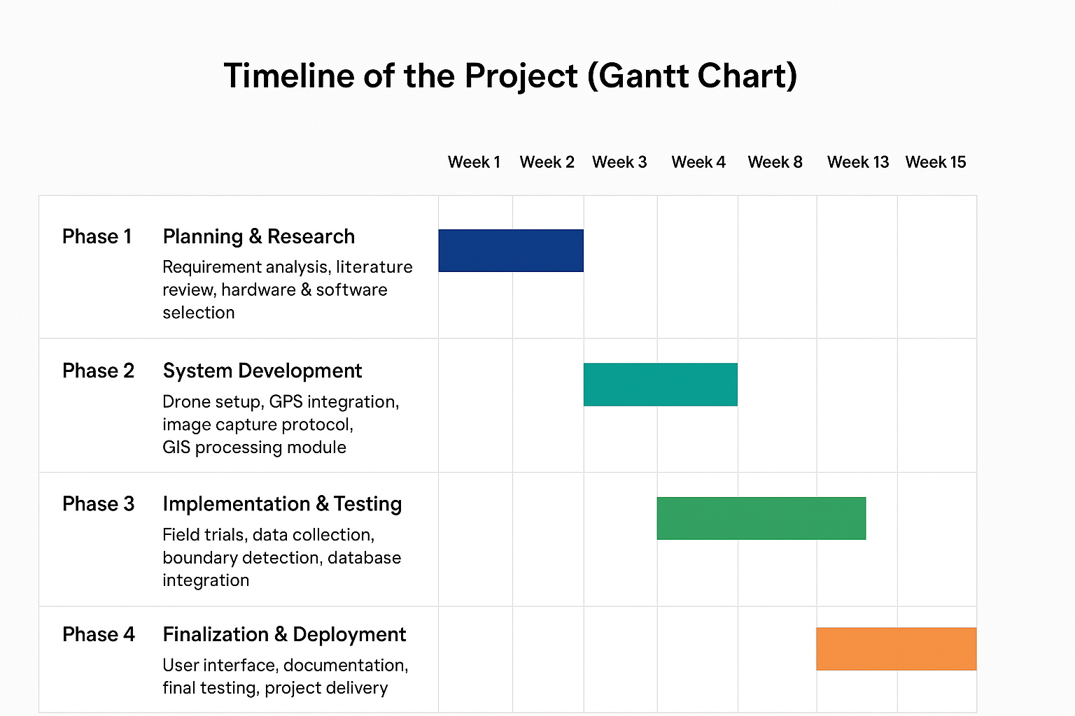
Timeline of the Project (Gantt Chart):
Phase | Description | Duration
Phase 1 | Planning & Research – Requirement analysis, literature review, hardware & software selection | Week 1 – Week 3
Phase 2 | System Development – Drone setup, GPS integration, image capture protocol, GIS processing module | Week 4 – Week 8
Phase 3 | Implementation & Testing – Field trials, data collection, boundary detection, database integration | Week 9 – Week 12
Phase 4 | Finalization & Deployment – User interface, documentation, final testing, project delivery | Week 13 – Week 15

Slide 11
References (IEEE Paper format) In Excel Format
Authors | Title | Journal/Conference | Volume/Issue | Pages | Year | Publisher/Organization | DOI/Link
F. E. Mohtich, M. El-Ayachi, S. Bensiali, A. Idri, and I. A. Hou | Deep learning approach applied to drone imagery for real estate tax assessment: Case of the tax on unbuilt land, Kenitra-Morocco | Int. Arch. Photogramm. Remote Sens. Spatial Inf. Sci. | vol. XLVIII-4/W5 | pp. 121–127 | 2022 | ISPRS | https://isprs-archives.copernicus.org/articles/XLVIII-4-W5-2022/121/2022/
B. Fetai, D. Grigillo, and A. Lisec | Revising cadastral data on land boundaries using deep learning in image-based mapping | ISPRS Int. J. Geo-Inf. | vol. 11, no. 5 | p. 298 | 2022 | MDPI | https://www.mdpi.com/2220-9964/11/5/298
M. Koeva et al. | Remote sensing for land administration 2.0 | Remote Sens. | vol. 14, no. 17 | p. 4359 | 2022 | MDPI | https://www.mdpi.com/2072-4292/14/17/4359
M. Dai, J. Hu, J. Zhuang, and E. Zheng | A transformer-based feature segmentation and region alignment method for UAV-view geo-localization | arXiv preprint | arXiv:2201.09206 | - | Jan. 2022 | arXiv | https://arxiv.org/abs/2201.09206
J. Xiao, D. Tortei, E. Roura, and G. Loianno | Long-range UAV thermal geo-localization with satellite imagery | arXiv preprint | arXiv:2306.02994 | - | Jun. 2023 | arXiv | https://arxiv.org/abs/2306.02994

Slide 12
References (IEEE Paper format)
[1] F. E. Mohtich, M. El-Ayachi, S. Bensiali, A. Idri, and I. A. Hou, “Deep learning approach applied to drone imagery for real estate tax assessment: Case of the tax on unbuilt land, Kenitra-Morocco,” Int. Arch. Photogramm. Remote Sens. Spatial Inf. Sci., vol. XLVIII-4/W5, pp. 121–127, 2022. https://isprs-archives.copernicus.org/articles/XLVIII-4-W5-2022/121/2022/
[2] B. Fetai, D. Grigillo, and A. Lisec, “Revising cadastral data on land boundaries using deep learning in image-based mapping,” ISPRS Int. J. Geo-Inf., vol. 11, no. 5, p. 298, 2022. https://www.mdpi.com/2220-9964/11/5/298
[3] M. Koeva et al., “Remote sensing for land administration 2.0,” Remote Sens., vol. 14, no. 17, p. 4359, 2022.
https://www.mdpi.com/2072-4292/14/17/4359
[4] M. Dai, J. Hu, J. Zhuang, and E. Zheng, “A transformer-based feature segmentation and region alignment method for UAV-view geo-localization,” arXiv preprint arXiv:2201.09206, Jan. 2022. https://arxiv.org/abs/2201.09206
[5] J. Xiao, D. Tortei, E. Roura, and G. Loianno, “Long-range UAV thermal geo-localization with satellite imagery,” arXiv preprint arXiv:2306.02994, Jun. 2023. https://arxiv.org/abs/2306.02994

Slide 13


